Slide 1
Appendix C
Vijayalakshmi Saravanan
CS 3853

Slide 2
A "Typical" RISC ISA
32-bit fixed format instruction (3 formats)
32 32-bit GPR (R0 contains zero)
Single address mode for load/store:
base + displacement
  no indirection
Simple branch conditions

Slide 3
Typical examples of Computers with Memory operands
No. of Mem Address | Max no. of operands allowed | Type of architecture | Examples
0 | 3 | Load-store | Alpha,ARM,MIPS,PowerPc,SPARC
1 | 2 | Register-Memory | IBM,Intel 8086,Motorola 6800
2 | 2 | Mem-Mem | VAX
3 | 3 | Mem-Mem | VAX

Slide 4
Cont..
Reg-Reg: Simple, fixed length, simple code generation model
Disadv: Higher instruction count which leads to larger program
Reg-Mem: Data can be accessed without a separate load intrn. Instrn format tend to be easy
Disadv: CPI vary by operand location
Mem-Mem: Most compact. No register wastage
Disadv: Large variation in intrn size, Memory access create bottleneck ( Not used today)

Slide 5
Example: MIPS
Register-Register (Ex: ADD, SUB etc)
31
26
25
21
20
16
15
11
10
0
Op
Rs
Rt
Rd
Register-Immediate (Ex: ADDI, SUBI, Load, Store etc)
31
26
25
21
20
16
15
0
Op
Rs
Rt
immediate
Branch (Ex: BEQZ)
31
26
25
21
20
16
15
0
Op
Rs
0
immediate

Slide 6
Implementation of RISC Instructions
1. Instruction Fetch cycle (IF)
IR ← Mem[PC] ; IR holds the instruction
NPC ← PC+4
2. Instruction decode/register fetch cycle (ID)
A ← Regs[rs] ; decode the instruction
B ← Regs[rt] ; in the meantime
Imm ← sign-extend imm field of IR ;Regs A, B, Imm
; ok if some of this is not needed

Slide 7
3. Execution /Effective address cycle (EX)
memory ref: ALU output ← A+Imm
Reg-Reg (ALU op): ALU output ← A op B
Reg-Immed (ALU op): ALU output ← A op Imm
Branch: ALU output ← NPC+ (Imm << 2)
;address of target
cond ← (A op O) ; op = equal,
= not equal
/* note: no instructions need to do 2 of these operations */
/* note: Imm has word count for branches; need to shift by 2 to get bytes to add to PC */

Slide 8
4. Memory Access/Branch Completion Cycle (MEM)
/* only for LD,ST,BR */
Memory access:
LMD ← Mem[ALU output] ;for loads. Store data in
; load mem data register
Mem[ALU output] ← B ; for stores
Branch
if (cond)
PC ← ALU output
else
PC ← NPC

Slide 9
5. Write-back cycle (WB)
Reg-Reg ALU instr: Regs[rd] ← ALU output
Reg-Imm ALU instr: Regs[rt] ← ALU output
Load Instruction: Regs[rt] ← LMD
Branches and stores → 4 cycles
Rest of ins → 5 cycles
Now we will try to pipeline it
We need: At the end of each cycle, the data is stored in some registers (PC,LMD,Imm,A,B,…). This allows other instructions to execute too.

Slide 10
If a program has 20% branch, 20% store and 60% other type of instructions, what is the CPI?
Ans: 4.6

Slide 11
What is Pipelining?
Pipelining - Overlap of instructions when they are independent. This potential overlap among instructions is called instruction-level parallelism (ILP) since the instructions can be evaluated in parallel.
The Major Hurdle of Pipelining-
Structural Hazards
Data Hazards
Control Hazards
2. How is Pipelining Implemented
3. What Makes Pipelining Hard to Implement?
4. Extending the MIPS Pipeline to Handle Multi-cycle Operations

Slide 12
Pipelining
Multiple instructions are overlapped in execution
Each is in a different stage
Each stage is called “pipe stage or segment”
Throughput: # inst completed/cycle
Each step takes a machine cycle
Want to balance the work in each stage
Ideally:
Time per instruction = Time per inst in a non-pipelined
# pipe stages

Slide 13
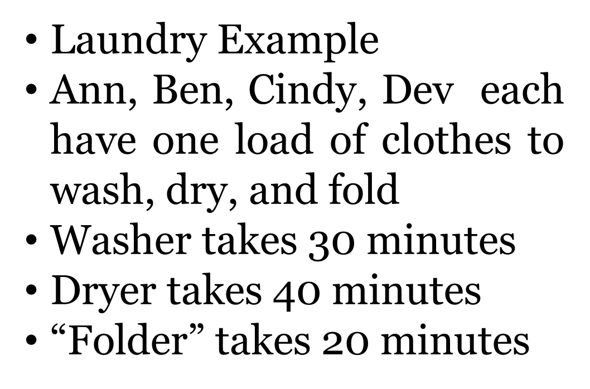
Example
A
B
C
D

Slide 14
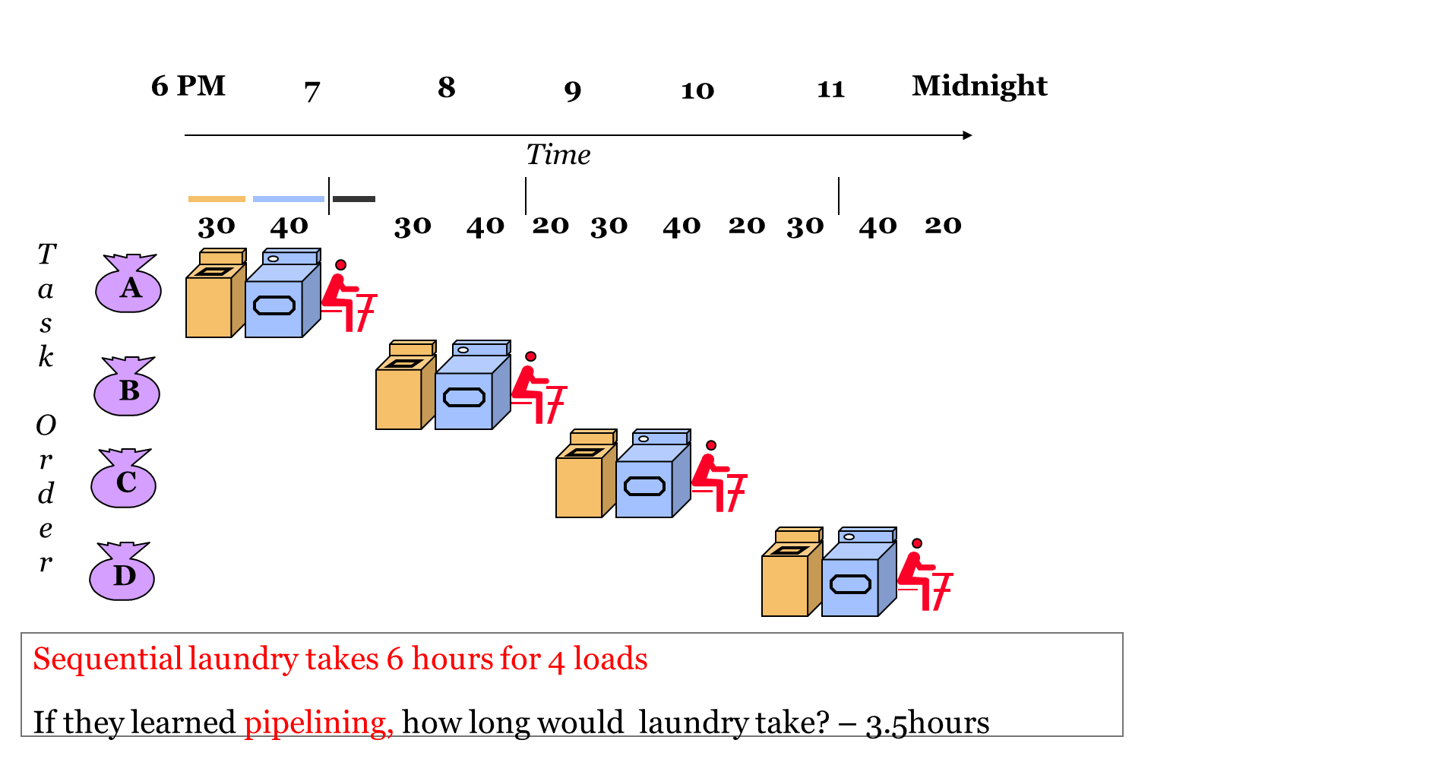
Cont…

Slide 15
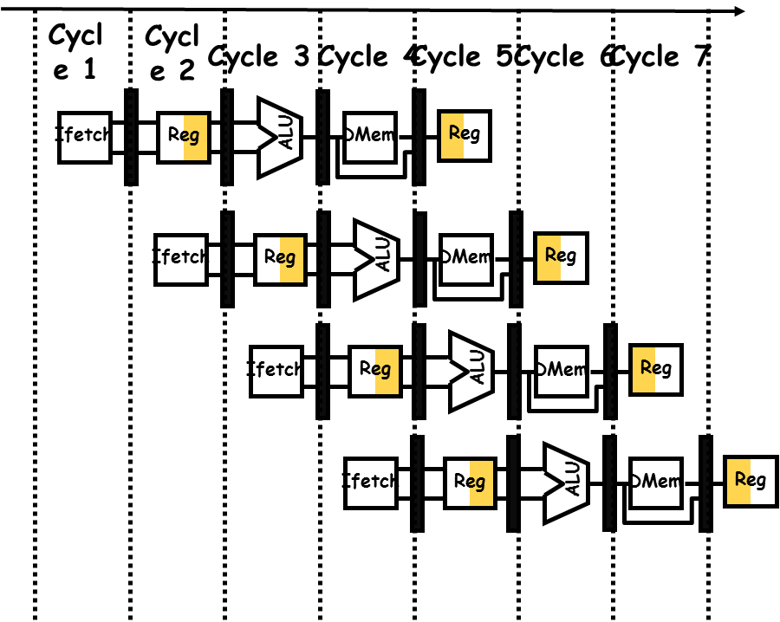

Slide 16
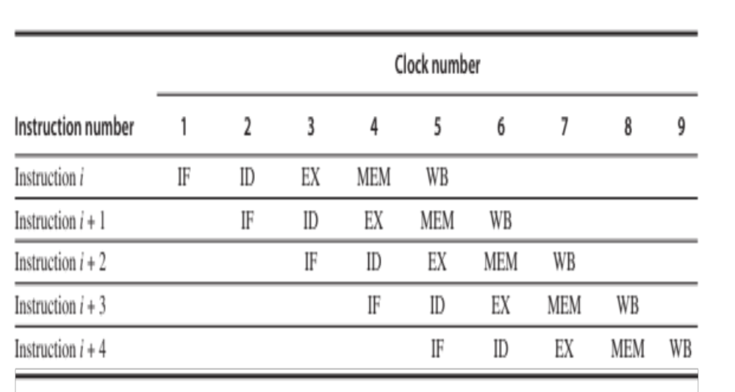

Slide 17
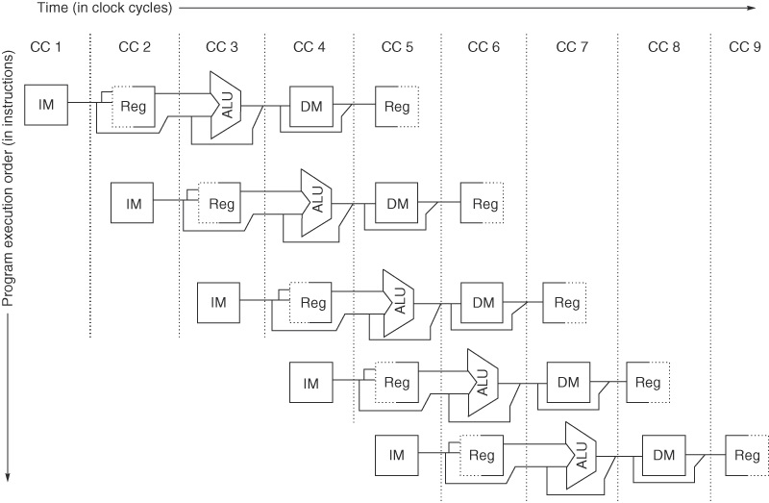

Slide 18
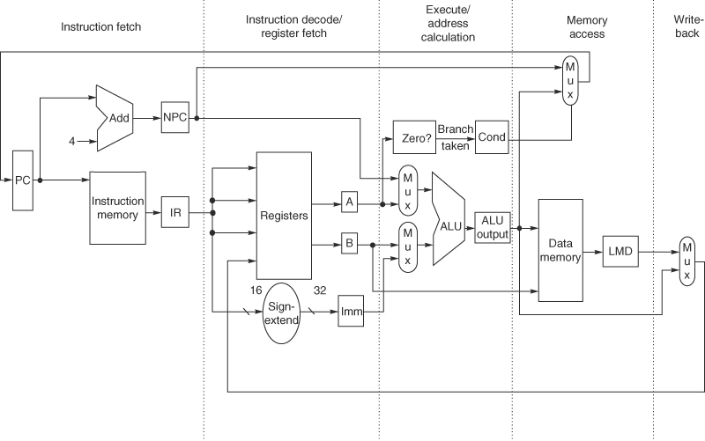

Slide 19
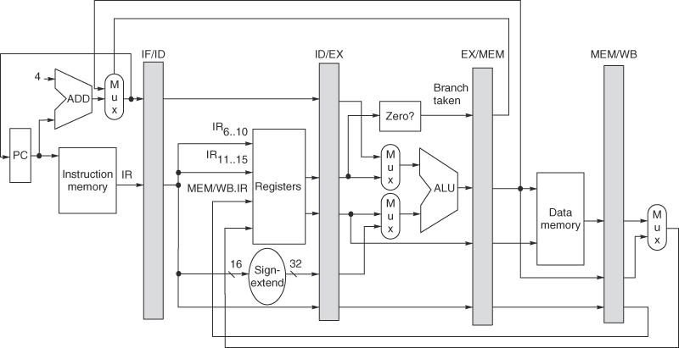

Slide 20
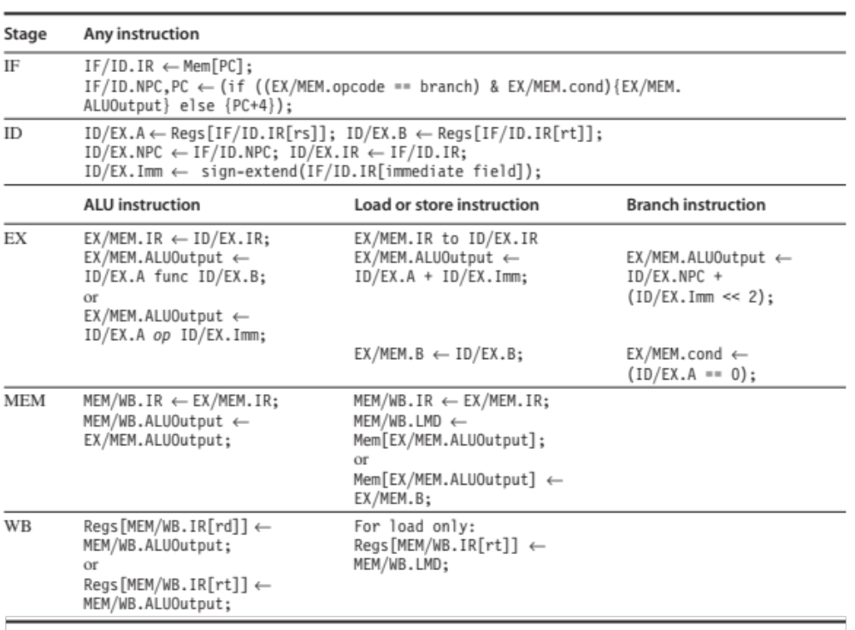

Slide 21
How to make it work?
Use separate I and D caches
Register file can be read/written in 0.5 cycles
PC: incremented in IF
if branch taken, in EX, add PC+ (Imm << 2)
Cannot keep any state in IR → need to move it to another register every cycle → see picture
These registers IF/ID, ID/EX, EX/MEM, MEM/WB subsume the temp ones
e.g. Destination Reg in a LD

Slide 22
Control of the pipeline:
set the control of the 4 MUXES

Slide 24
Selects PC+4 or branch target address

Slide 25
MUX is set by whether it is a branch or not
selects PC + 4 or Reg[rs]

Slide 26
MUX is set by whether it is a reg-reg ALU op or not
selects Reg[rt] or Immidiate

Slide 27
MUX is set by whether it is a load or not
selects data or ALU output

Slide 28
One more MUX should be here
WHY???

Slide 29
A final MUX (not shown) in WB: chooses the field in IR that determines what reg to use to store the result
  in reg-reg ALU MEM/WB. IR_{16…20}
  in reg-imm ALU and LD MEM/WB. IR_{11…15}
(rd)
(rt)

Slide 30
Example
Un-pipelined: 10ns cycle time
4 cycles for ALU (40%), branch (20%)
5 cycles for mem (40%)
pipelining: adds 1 ns to clock
speedup in execution rate?
Un-pipelined: avg inst time = clock * avg CPI = 10*((40%+20%)*4 + 40%*5) = 44 ns
pipelined = clock * avg CPI = 11 ns * 1 = 11ns
Speedup= 44/11 = 4

Slide 31
Pipeline Hurdles
Limits to pipelining: Hazards prevent next instruction from executing during its designated clock cycle
  Structural hazards: HW cannot support this combination of instructions
  Data hazards: Instruction depends on result of prior instruction still in the pipeline
  Control hazards: Pipelining of branches & other instructions that change the PC
  Common solution is to stall the pipeline until the hazard is resolved, inserting one or more “bubbles” in the pipeline increases CPI, decreases performance
  better solution: partial stall

Slide 32
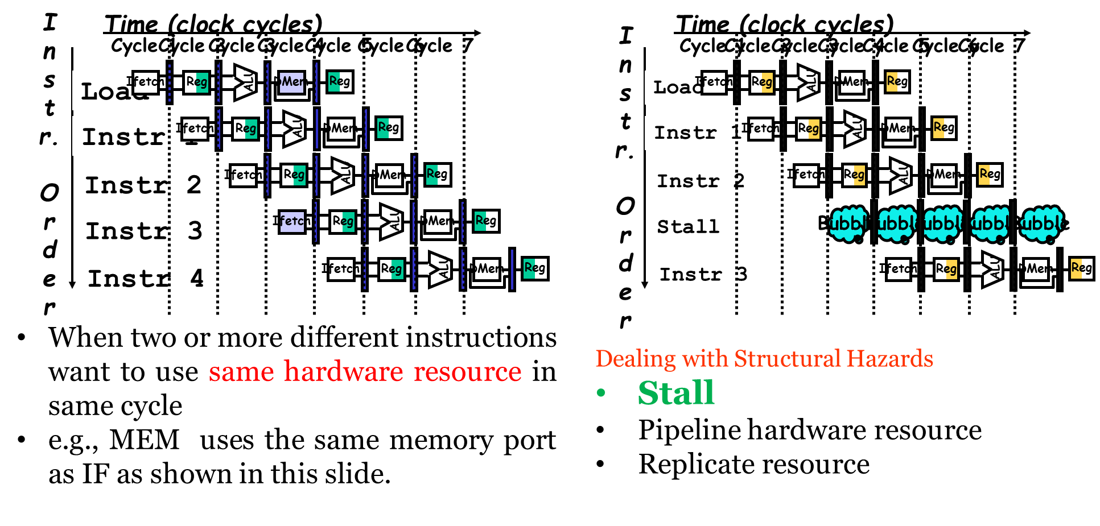

Slide 33
Data Hazards
Occur when there are instructions active that need to access the same data (memory or register) locations.
Where there’s real trouble is when we have:
instruction A
instruction B
and B manipulates (reads or writes) data before A does. This violates the order of the instructions, since the architecture implies that A completes entirely before B is executed.

Slide 34
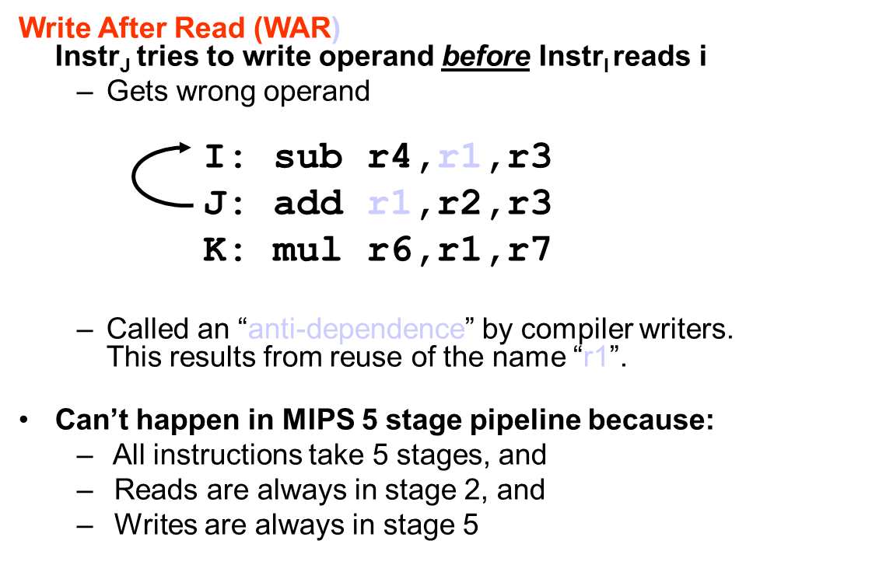
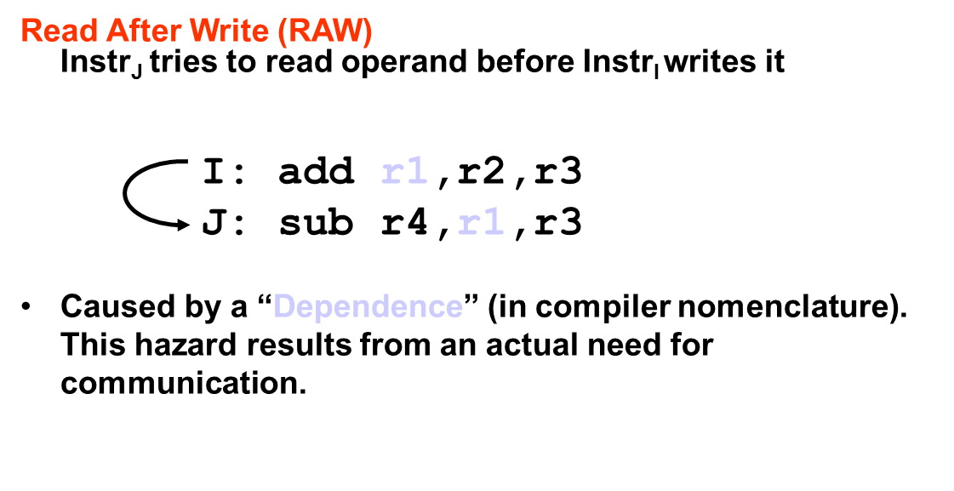
Simple Solution to RAW
Bypass/forward/short­circuit
Use data before it is in the register
  + reduces/avoids stalls
  -- complex
Crucial for common RAW hazards

Slide 35
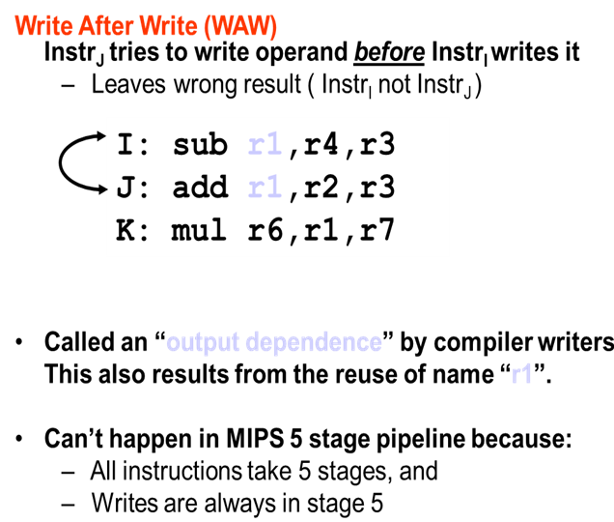

Slide 36
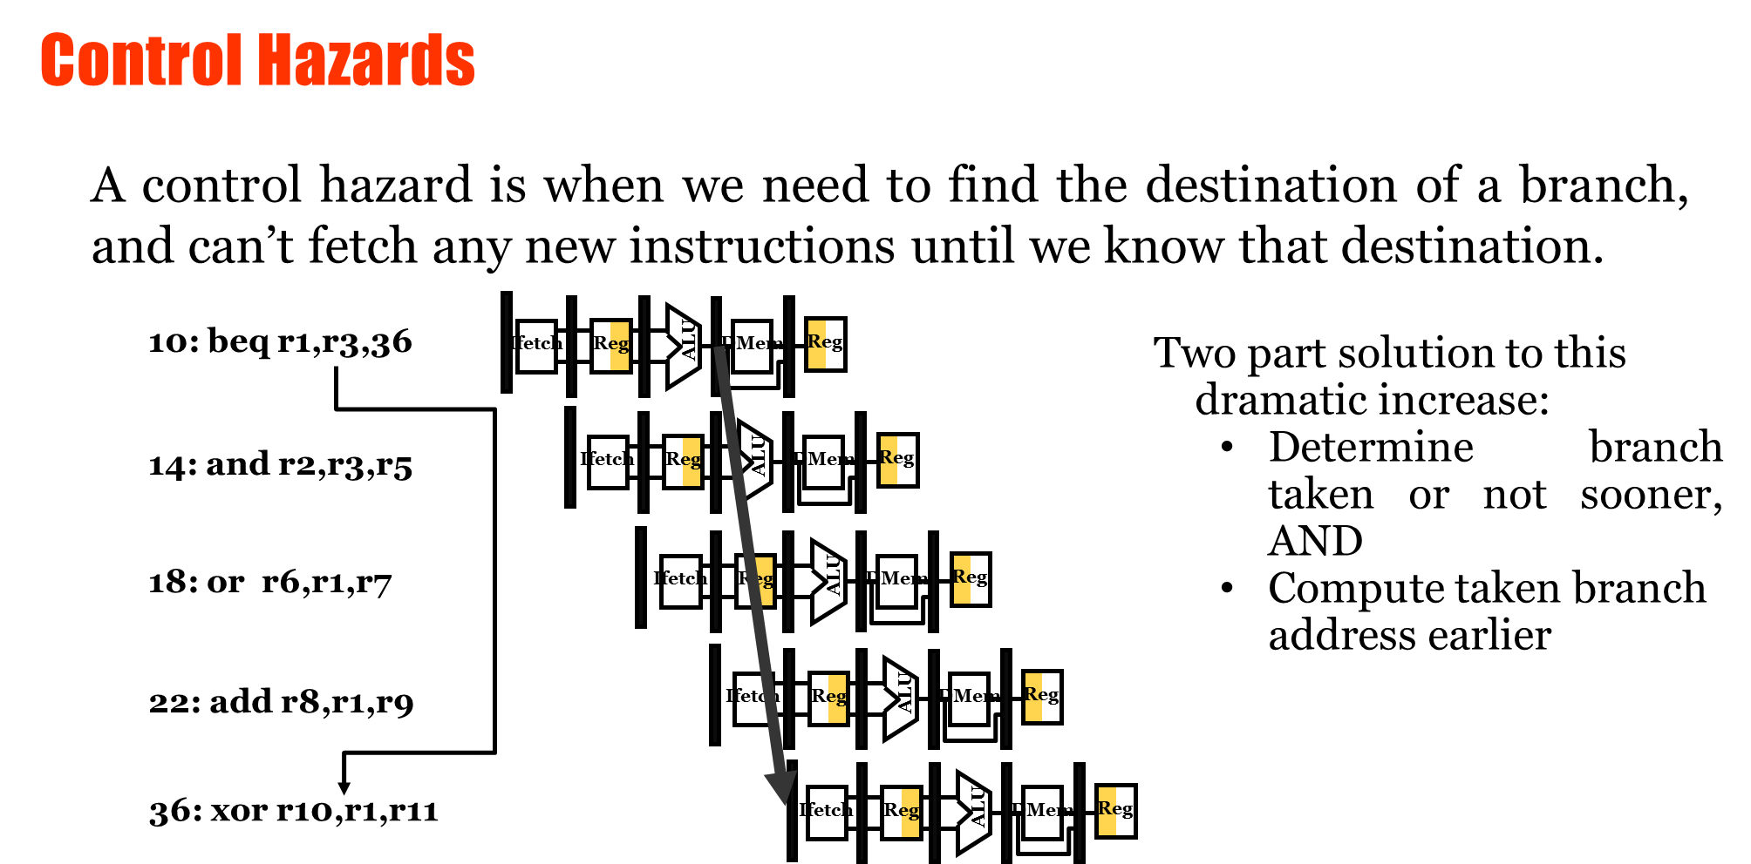

Slide 37
Pipeline Hazards
Situations that prevent the next instruction from executing its designated clock cycle
→ Structural: resource conflicts e.g. 2 people want to use 1 laptop at the same time
→ Data: instruction depends on the result of a previous one. e.g. all the exam and h/w grades are required before calculating the final grade
Control: results from instructions that change the PC. e.g. BEQZ
  First choose your course and then buy books
→ Pipeline may have to stall

Slide 38
CPI = Ideal CPI + Pipeline stall clock cycles per inst.
pip

Slide 39
Structural Hazards
Some Combination of inst. Cannot be accomodated because of resource conflicts
Usually because some functional unit is not pipelined two instructions using it cannot proceed back to back
Some resource has not been replicated enough Eg 1 register file port Combined I,D memory
Result : Pipeline stall, like if we had inserted a bubble.

Slide 40
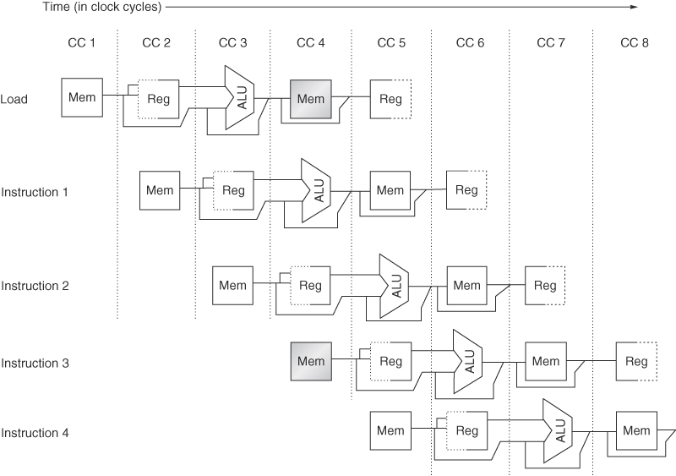

Slide 41
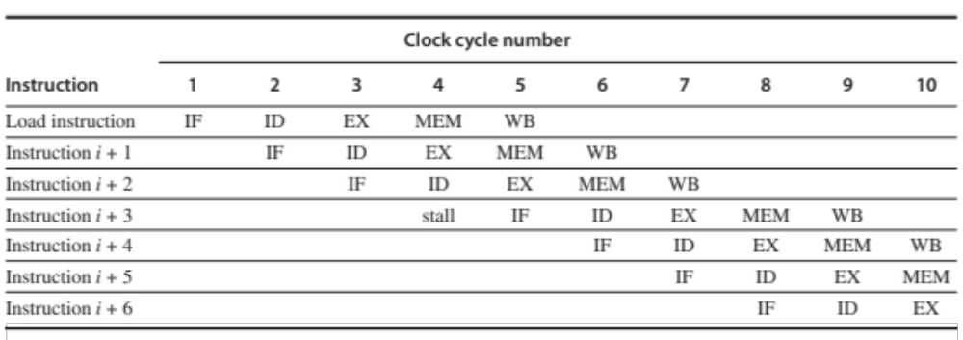

Slide 42
Data Hazards
Occurs because pipelining changes the order of read/write accesses to operands
1 ADD R1, R2, R3
2 SUB R4,R5,R1
3 AND R6,R1,R7
4 OR R8,R1,R9
5 XOR R10,R1,R11

Slide 43
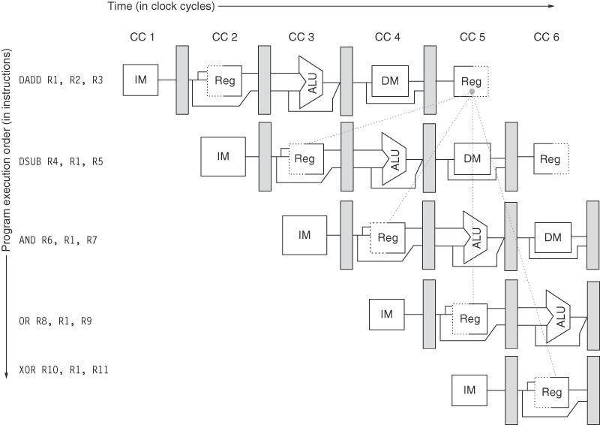

Slide 44


Slide 45
Feed ALU result back from EX/MEM or MEM/WB
to ALU input

Slide 46
Forwarding, Bypassing or Short Circuiting

Slide 47
Write into Reg File in the 1st ½ Clock Cycle
Read from Reg File in the 2nd ½ Clock Cycle

Slide 48
Forwarding
Need forwarding path to the data memory input
ADD R1 , R2 , R3
LW R4 , 0(R1)
SW 12(R1) , R4

Slide 49
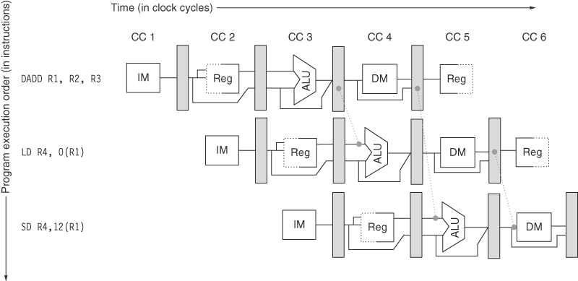

Slide 50
Need forwarding path from memory output to memory input

Slide 51
HW Change for Forwarding
NextPC
ID/EX
EX/MEM
MEM/WR
mux
Registers
ALU
Data
Memory
mux
mux
Immediate

Slide 52
Another Example
LD R1, 0(R2)
DSUB R4, R1, R5
AND R6, R1, R7
OR R8, R1, R9

Slide 53
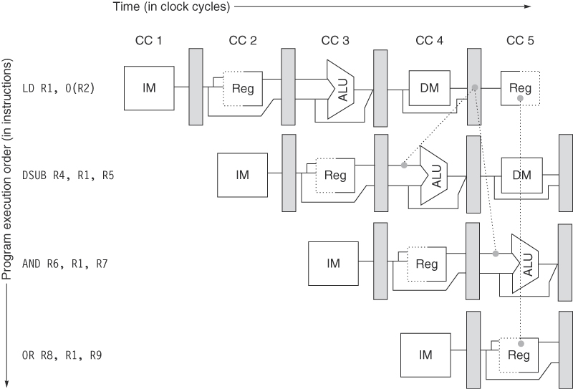

Slide 54
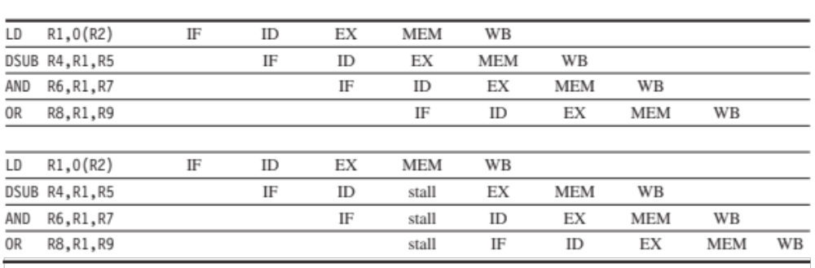

Slide 55
All later instructions from hazard point are stalled

Slide 56
How to handle these hazards
Add hardware(pipeline interlock) to detect hazard and
then stall the pipeline until the hazard is cleared
  The CPI of the SUB instruction increases by 1

Slide 57
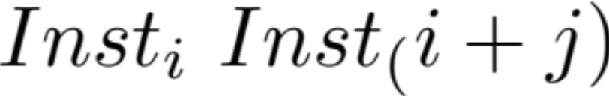
Classifying Data Hazards
1.
Wr Rd
2.
Wr Wr
3.
Rd Wr
4.
Rd Rd

Slide 58
Classifying Data Hazards
RAW(Read after Write) : i + 1 tries to read before i writes
        ADD R1
        ADD R7 , R1
WAW(Write after Write) : i + 1 tries to write before i writes
  Not Possible in MIPS – WHY?
WAR( Write after Read) : i + 1 tries to write before i reads
  Not possible in MIPS because instruction reads first in ID, writes in WB
  Occurs when some instructions write early and read late
RAR( Read after Read) : No Hazard

Slide 59
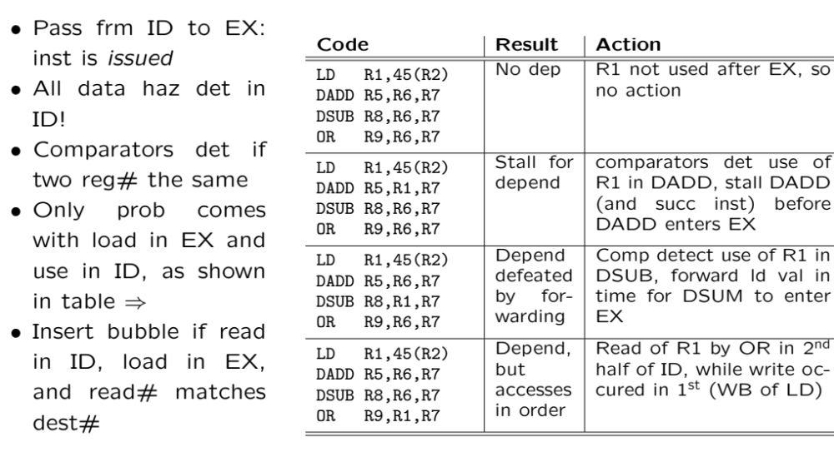
Control of MIPS Pipeline

Slide 60
Control Hazards: Branches
When a branch is executed , it may or may not be taken
If taken , the PC is not changed until the end of EX -> end of address calculation
Branch
IF ID EX MEM WB
Successor
IF IF IF ID EX MEM WB
Successor + 1
IF ID EX MEM WB

Slide 61
Control Hazards: Branches
When a branch is executed , it may or may not be taken
If taken , the PC is not changed until the end of EX -> end of address calculation
Branch
IF ID EX MEM WB
Successor
IF IF IF ID EX MEM WB
Successor + 1
IF ID EX MEM WB
Overall 2 cycles lost

Slide 62
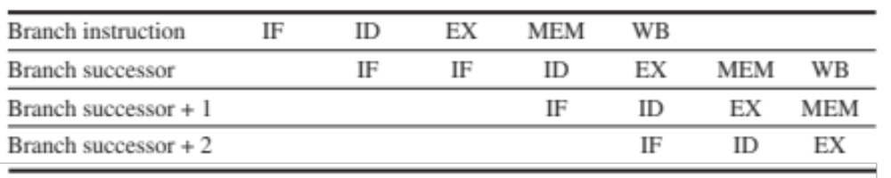
Reducing Branch Stalls
Do, as soon as possible :
  Find out whether or not the BR is taken
  Find out the target addr.
How ?
  - move the zero test (condition test) to ID
  Compute the target in the ID (instead of EX)
  -> requires extra adder
  -> therefore : only 1 clock cycle stall ( Branch delay)

Slide 63
Reducing Branch Stalls
Do, as soon as possible :
  Find out whether or not the BR is taken
  Find out the target addr.
How ?
  - move the zero test (condition test) to ID
  Compute the target in the ID (instead of EX)
  -> requires extra adder
  -> therefore : only 1 clock cycle stall ( Branch delay)
Still 10% - 30% performance loss

